Slide 1
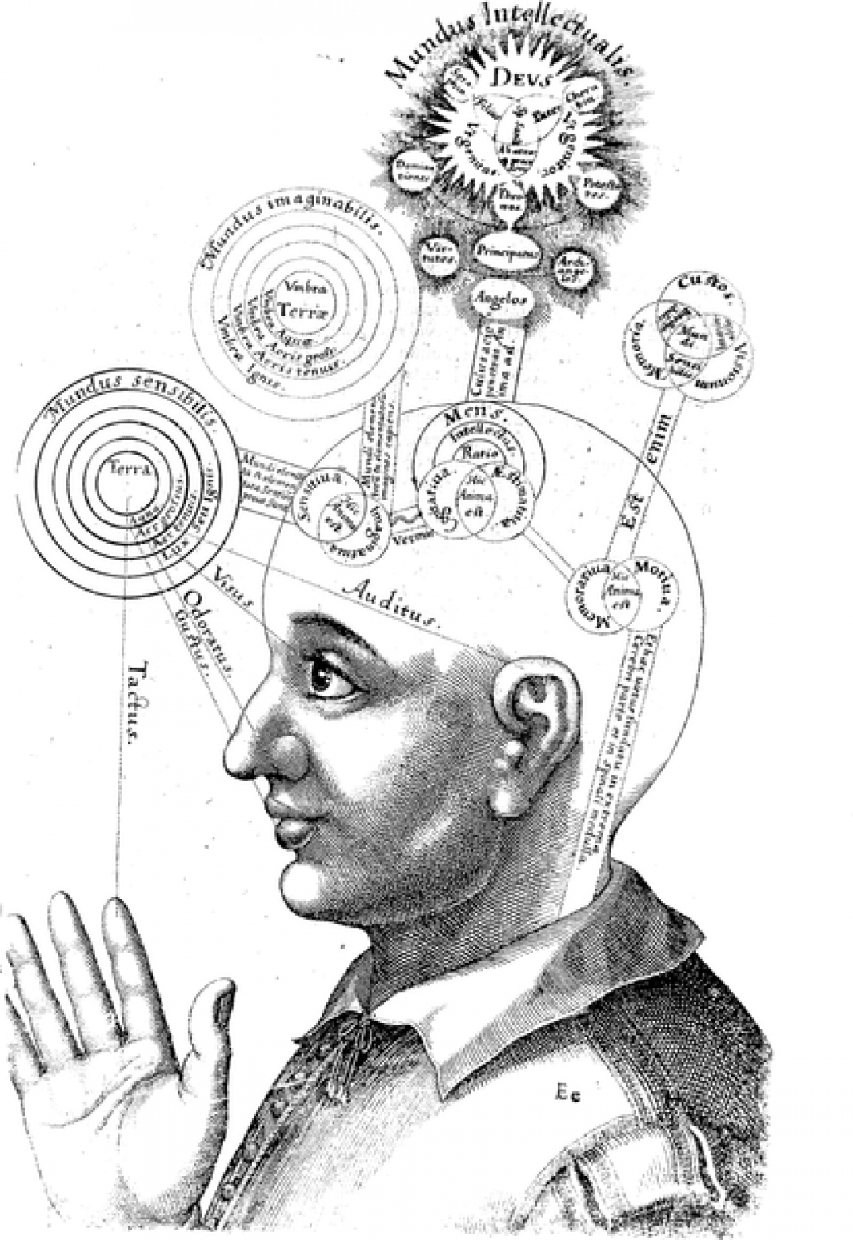
Internalism & Skepticism
Kareem Khalifa
Department of Philosophy
Middlebury College

Slide 2
Overview
Background
Vogel vs. Skepticism
Objections to Vogel
Fumerton

Slide 3
1. Background

Slide 4
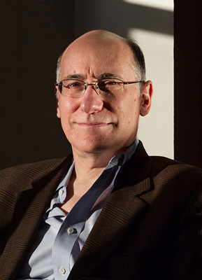
2. Vogel vs. Skepticism
2.1. IBE
2.2. Big Picture

Slide 5
2.3. Argument for P2
2.3.1. Big Picture
2.3.2. Why not MSH?
2.3.3. Why not ISH?

Slide 6
3. Objections to Vogel
3.1. IBE Skepticism
3.2. Vogel’s Reply
3.3. Fumerton’s Objections

Slide 7
4. Fumerton
4.1. Competitors
4.2. Epistemic probability

